Slide 1
​Module 1.2 – Course Introduction
Introduction to Robotics

Slide 2
What Do Today’s Robots Look Like?

Slide 3

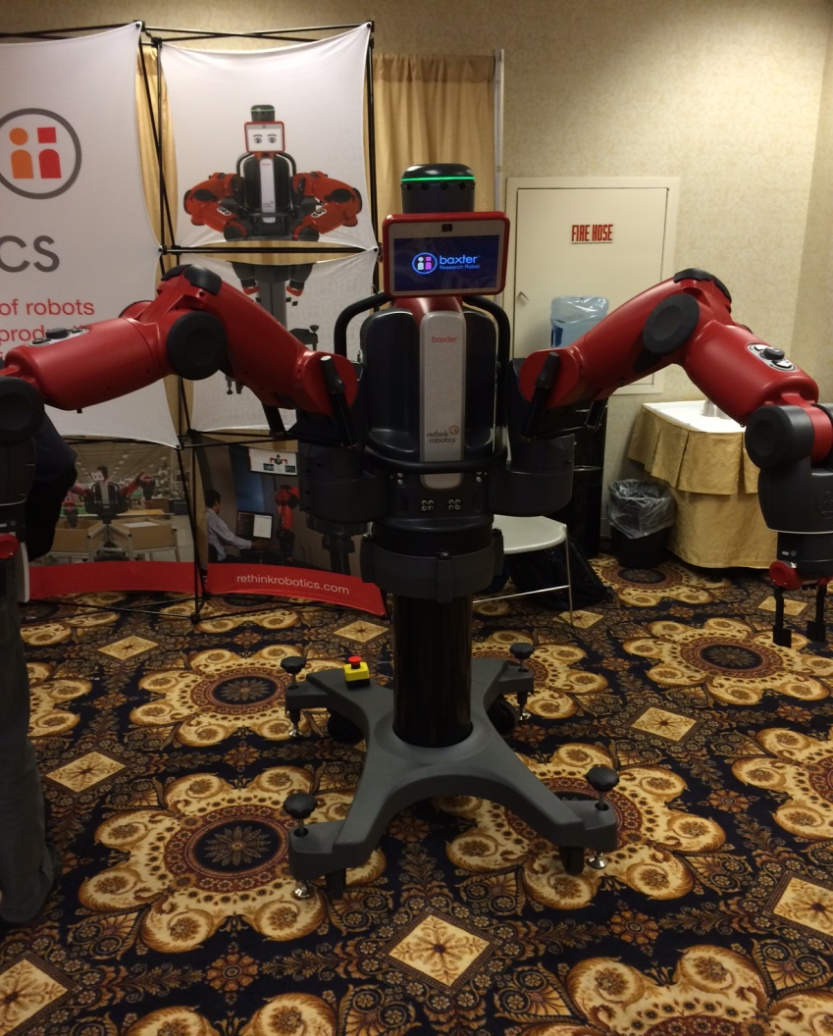
Rethink Robotics - Baxter
Baxter gives out ‘free hugs.’
Robots are friendly. Promise!
Notes:
Runs ROS, and is available for about 25k USD. Founded by iRobot CTO Rodney Brooks

Slide 4
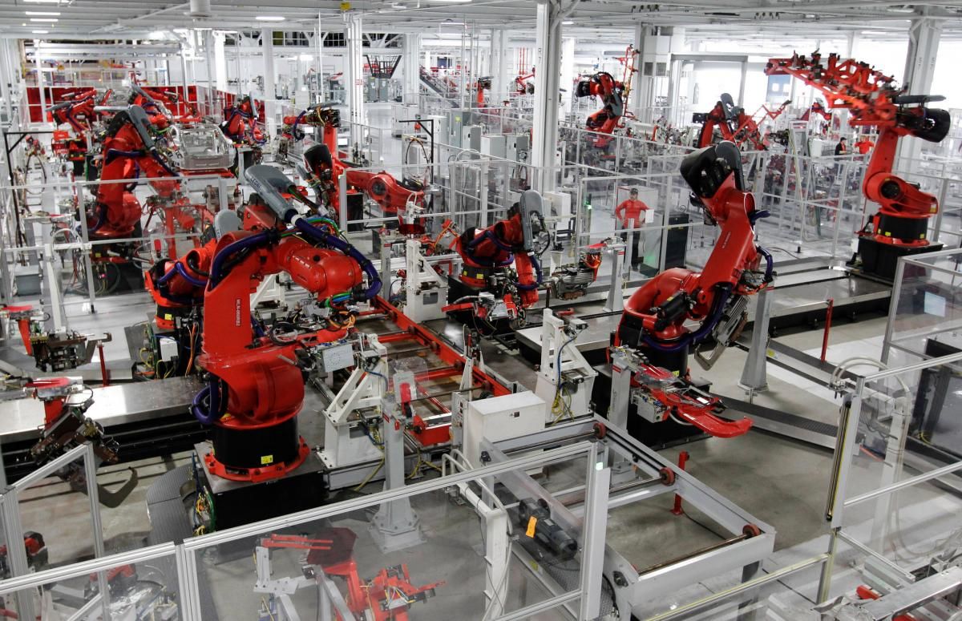
Kuka at the Tesla Factory
No need for tools, just swap out your hands!
Notes:
Note the interchangeable hands.
Laser curtains provide safety.

Slide 5
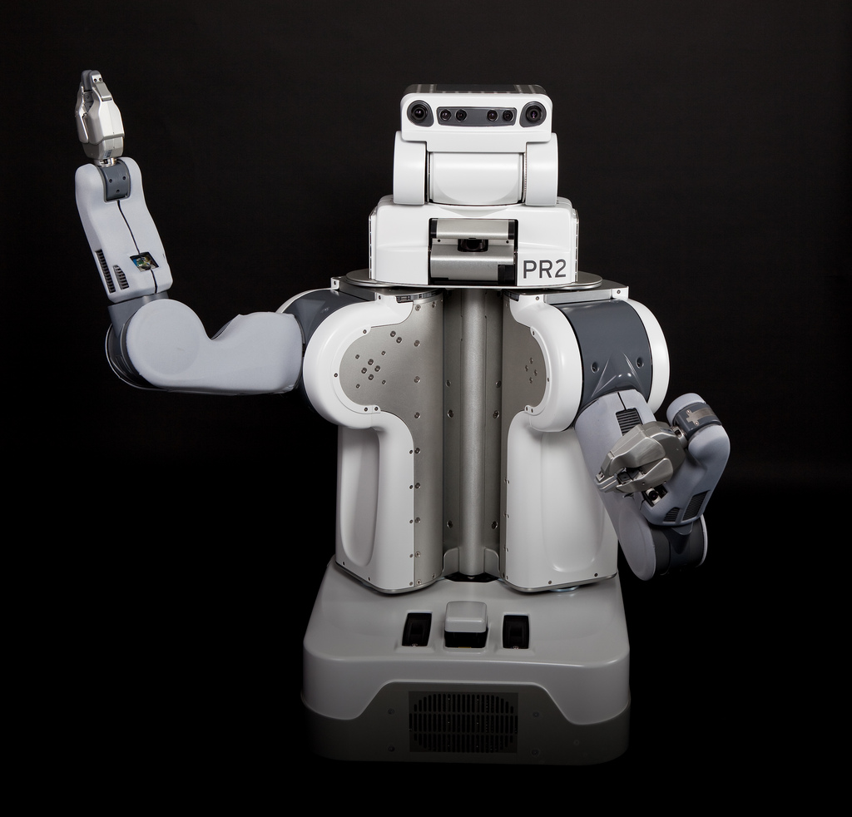



Willow Garage and the PR2
Founded in 2005
Created ROS, Robot Operating System
Hired Gary Bradski, one of OpenCV’s founding contributors
Maintained OpenCV prior to dissolution
Clearpath Robotics supports, but does not sell the PR2
Willow Garage is no more (2013Q4)

Slide 6
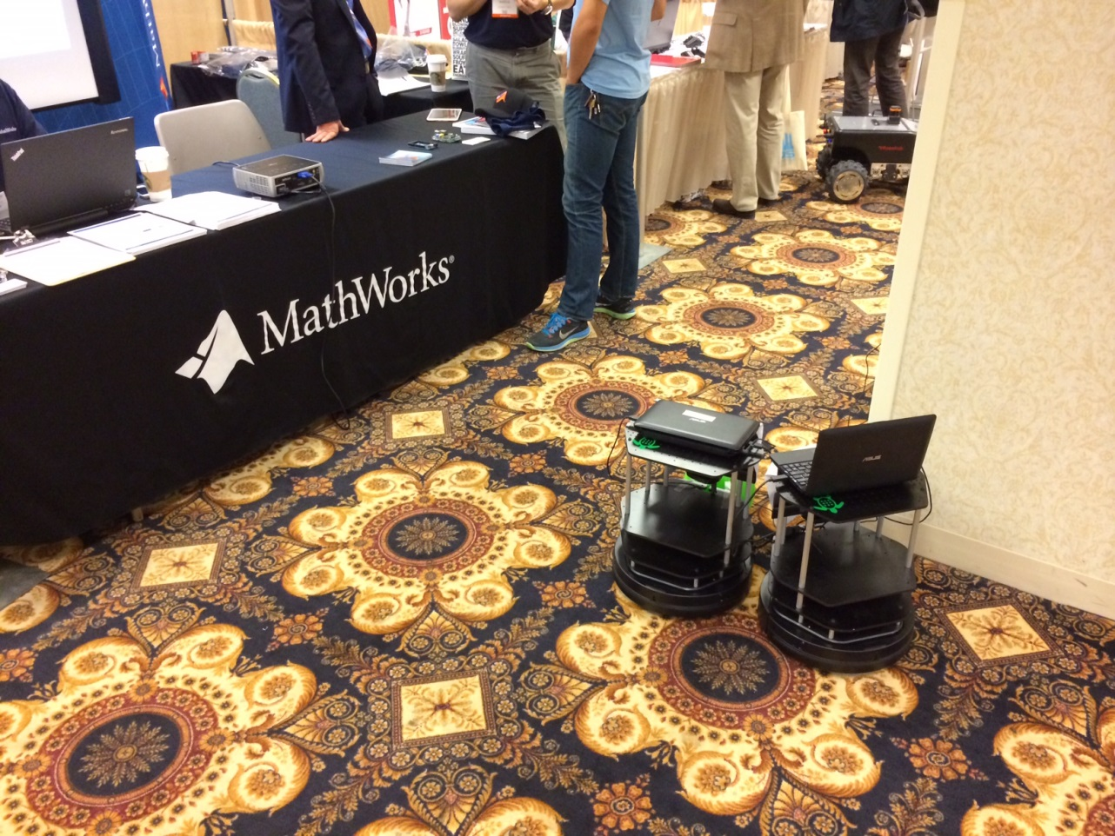
Clearpath - TurtleBot
Inherited from Willow
Notes:
Netbook with CPU and GPU, but unpopular: a notebook is overkill.
@ $1500

Slide 7
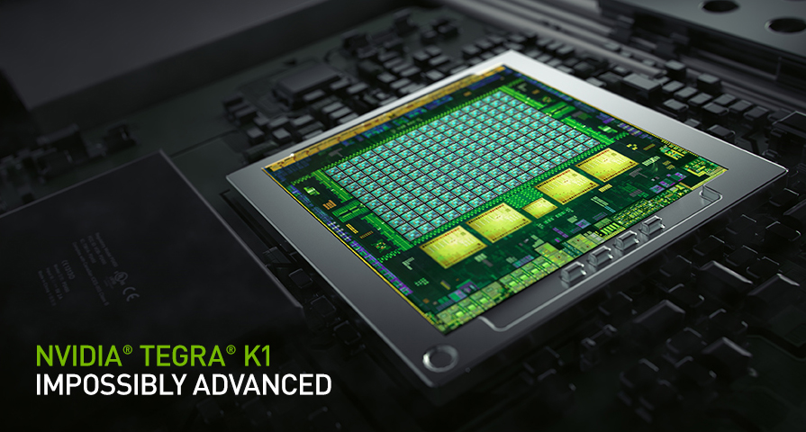
The Tegra K1
System-on-chip
Fastest quad-core Cortex A15 on the market, in 90% of benchmarks
Includes Kepler-class GPU
Supports CUDA 3.2, RenderScript
Ships in multiple form factors, with Android and Ubuntu Linux
Uses OMX for video decode instead of VDPAU
Uses no more than 5 watts*
*unless you use every CUDA core; then draws up to 11 watts on Ubuntu

Slide 8
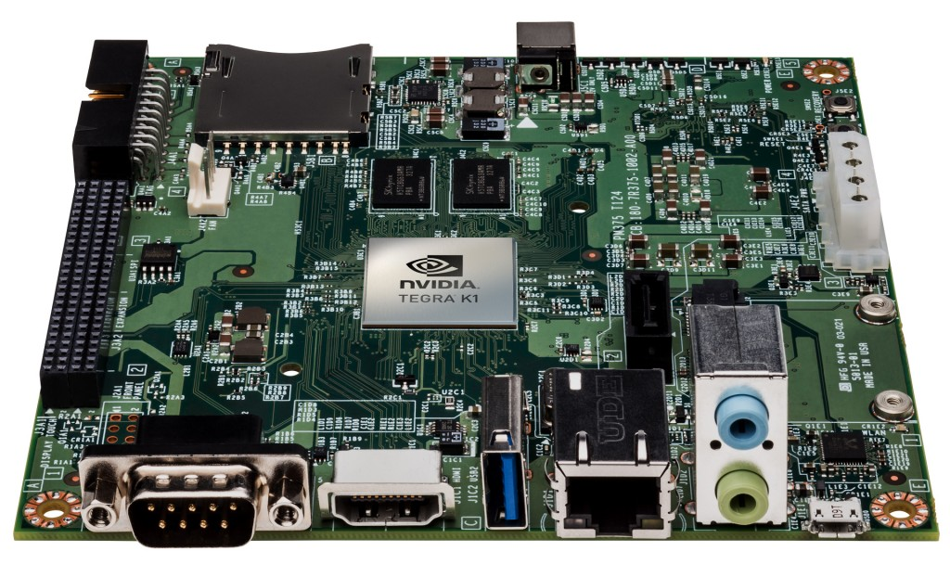
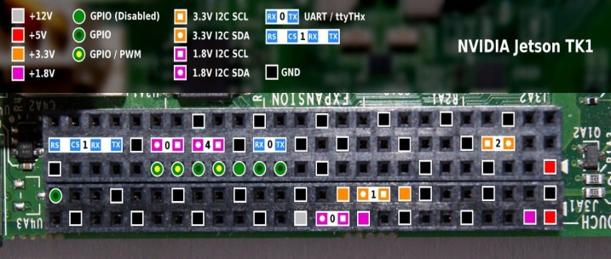
The 192-Core
Jetson TK1 Developers’ Board
Supports the following:
HDMI, duplex stereo audio, USB 3.0, USB 2.0, SD, SATA, Gigabit Ethernet, miniPCI-Express, DB-9 serial, JTAG
GPIO: 7 pure GPIO, 3 I2C, UART, CSI-MIPI camera interface (1x, 2x), DisplayPort 1.2
Ships with Ubuntu 14.04 LTS
Runs Unity desktop GL-accelerated
Sold online at Maplin in the UK (199 GBP)
Seen in the wild running CM 11.0
*with NVIDIA proprietary driver, supporting OpenGL 4, GLSL, CUDA 6, or nouveau open-source driver (not all features available)

Slide 9
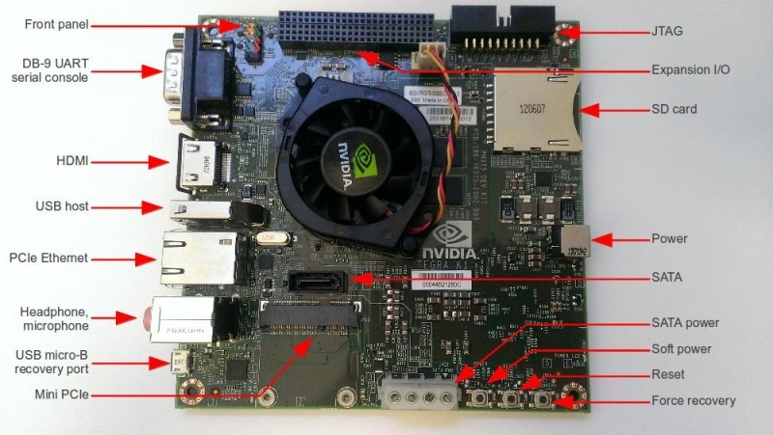

Pinout Diagrams Courtesy of Corneliusz Jarzebski

Slide 10
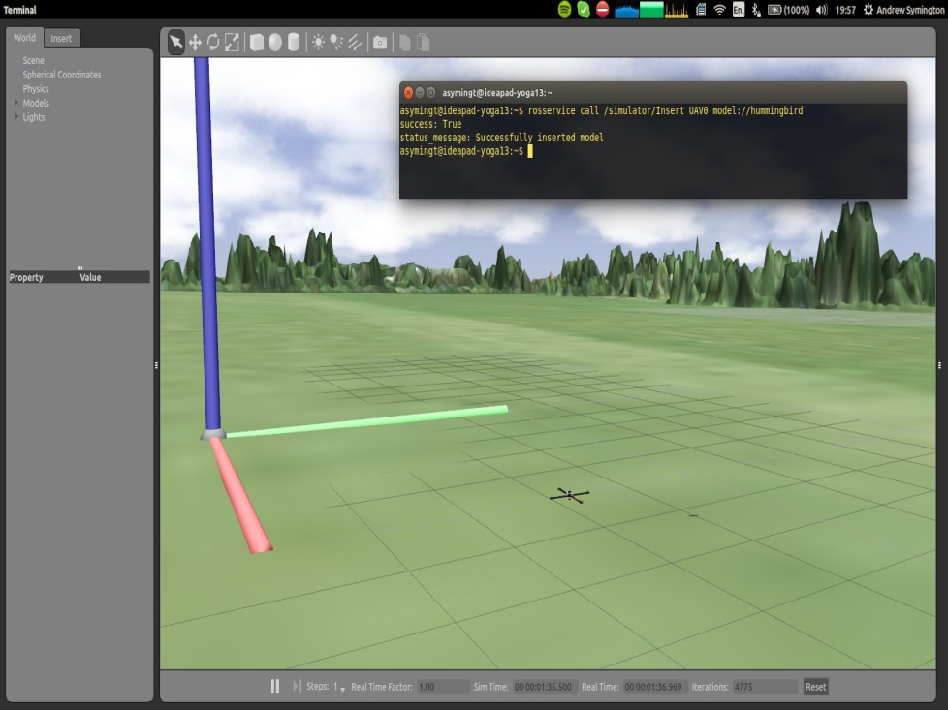
Robot Operating System (ROS)
What is it?
Standardized package manager
Runs on Ubuntu
Standardizes message-protocols for:
Pose estimation
Localization
Navigation
Computer vision
Incorporates the latest contributions from academia
Andrew Symington, UCL Gazebo and rviz with several quadrotors, ROSCon 2014

Slide 11
Computer Vision Sounds Awesome… …But what is it?

Slide 12
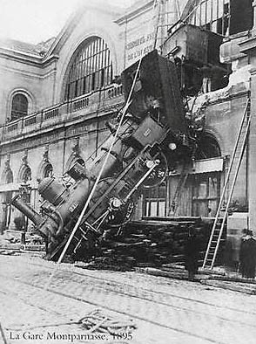
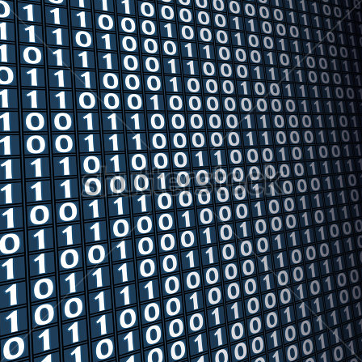
CV: Glad you asked.
Perception and interpretation of sensory signals
What we see
What a computer sees
Or simply: give meaning to images and videos
Notes:
Computer vision means perception and interpretation of sensory signals.
<click> Whereas we see lots of things here: a train, an accident,
<click> the computer only sees a string of numbers.
<click> The challenge is to tease out the meaning from these numbers that encode images and videos.

Slide 13
Challenge: Lighting Conditions
Graphics is hard, vision is harder slide
Notes:
The same scene, even from the same point of view, may look dramatically different under different lighting conditions.

Slide 14
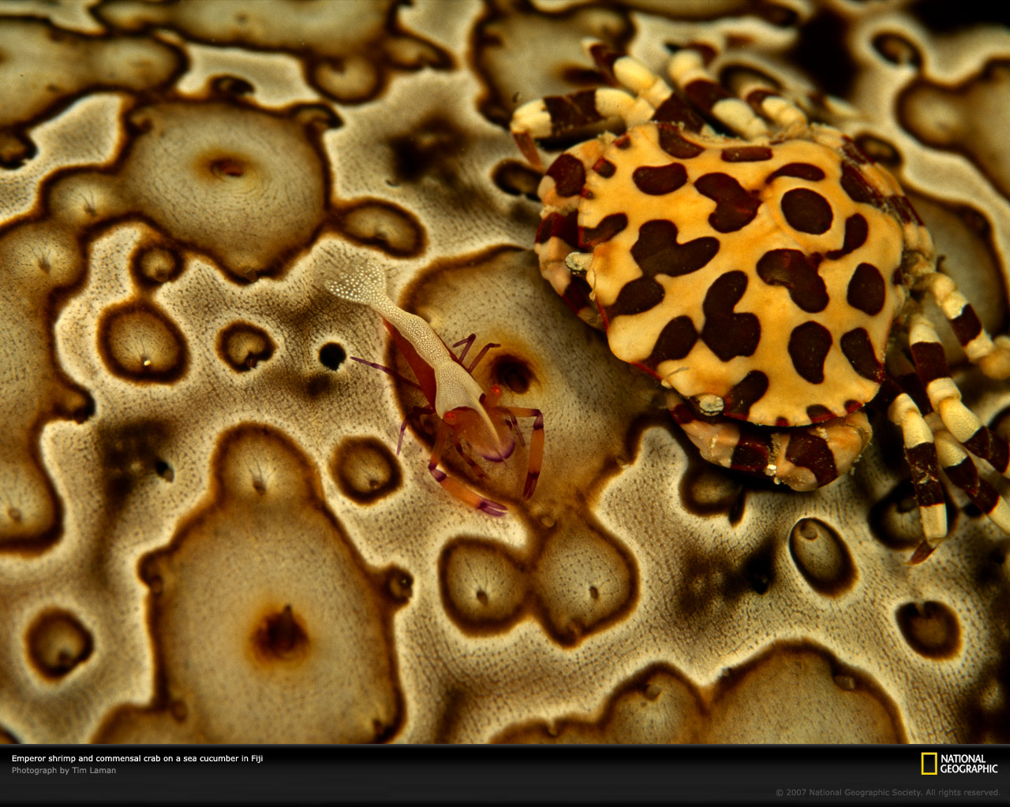
Challenge: Background Clutter
Notes:
It is often not even easy to separate what are the objects in the foreground,
in this case two crabs,
and what is the background surface on which they are located.

Slide 15
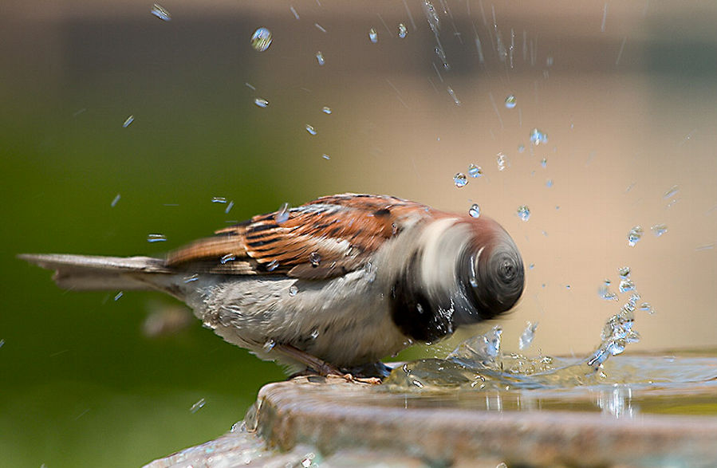
Challenge: Motion
Notes:
When objects move fast, they become blurred, and difficult to recognize.

Slide 16
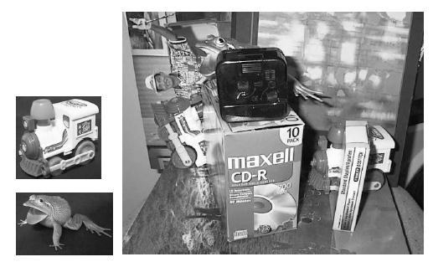
Challenge: Occlusion
Notes:
And often the objects remain partially hidden,
and are difficult to find among the clutter,
<click> like the toy frog,
<click> or the two train engines.

Slide 17
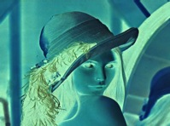

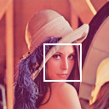
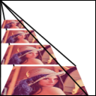
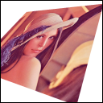
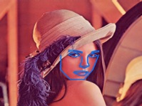
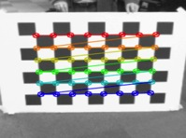
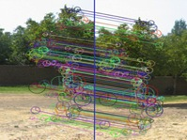

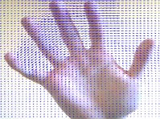
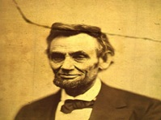
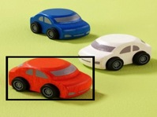


OpenCV Library
Initially developed by Intel for single-core x86 CPUs
OpenCV4Tegra — Accelerated CUDA+NEON+GLSL+TBB multithreading
Image processing
General Image Processing
Segmentation
Machine Learning, Detection
Image Pyramids
Transforms
Fitting
Video, Stereo, and 3D
Camera Calibration
Features
Depth Maps
Optical Flow
Inpainting
Tracking
Notes:
OpenCV is an open source vision prototyping library
which has been downloaded over 3 Million times and has over 900 algorithms
OpenCV4Tegra comes with the Tegra SDK, and provides Tegra-specific acceleration for OpenCV
using OpenGL ES GLSL, ARM multithreading and NEON optimizations, and CUDA.
[Tegra Optimized Functions
50+ NEON and GLSL optimized functions
250 CUDA optimized kernels]

Slide 18
Neural Networks
Third time is the charm
50’s
80’s
10’s
Notes:
Neural networks were popular for a while in the 50’s and 60’s, giving a promise of doing similar computations as we do in our brains.
They were forgotten for a while,
<click> resurfacing in the 80s, then forgotten again.
<click> Now in this decade they are changing how computer vision is done and what can done with it.

Slide 19

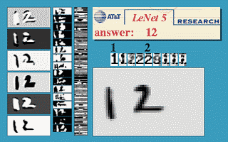
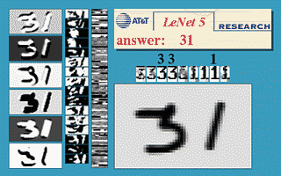
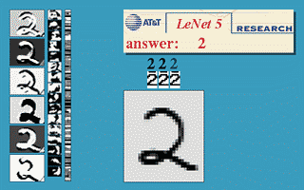
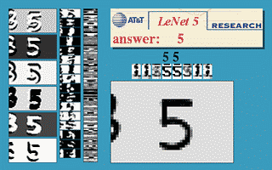
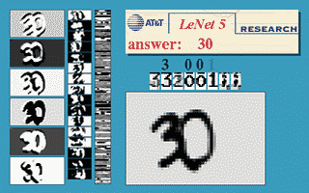
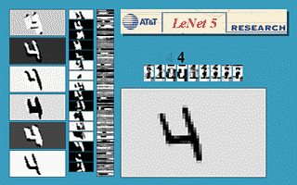
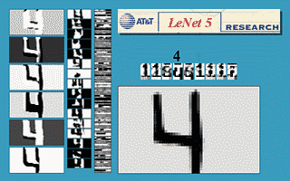
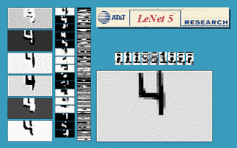
Notes:
One of the successes in the 80’s was using convolution networks to analyze handwritten characters.
These systems were used to scan and decode mailing addresses on envelopes, and the money amounts in personal checks.
But those early systems mostly failed on more complex tasks.

Slide 20
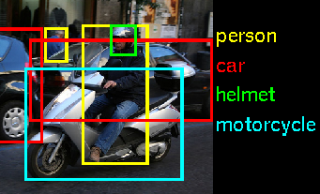
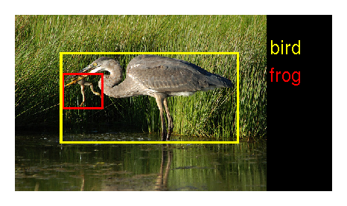
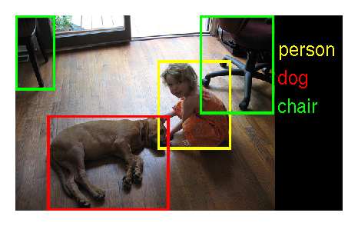
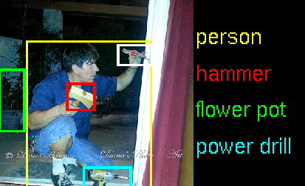
ImageNet Recognition Challenge
1.2M training images, 1000 object categories
person
car
helmet
motorcycle
bird
frog
person
hammer
flower pot
power drill
person
dog
chair
Notes:
The modern deep learning systems can handle much more challenging vision tasks than recognizing handwritten characters.
Imagenet is a research competition where computer vision and machine learning systems first get to see over a million images of 1000 different types of objects.
Then they are given new images that they haven’t seen before, and they need to recognize and locate the objects in those images.

Slide 21
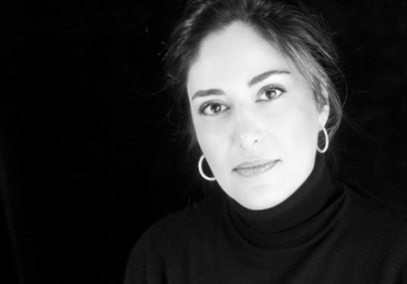
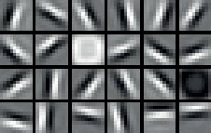
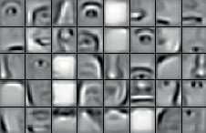
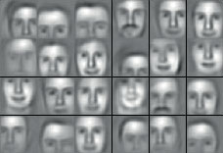
Deep Neural Networks
Learning by abstraction
(Weights)
Image
“Sara”
Notes:
This diagram shows how a deep convolutional network works.
On the left, the image is passed to the network.
<click> The first convolution layer applies various filters on the image, producing new “images”, where a high value indicates a presence of a low-level features such as an edge, or a disk shape.
<click> The deeper layers are a bit more difficult to visualize, but we can show what kind of features they respond to.
The next layer could be sensitive to face segments, such as an eye or a nose or an eyebrow,
<click> and a yet deeper layer could be sensitive to types of faces.
The final layers then interpret the presence of different features as probabilities of a particular object being in the image, and gives a high likelihood that this is a picture of a woman called Sara.

Slide 22
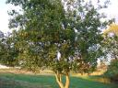
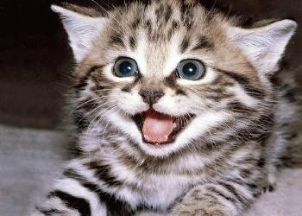
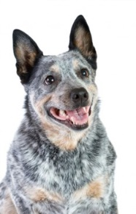
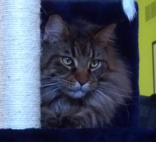
Deep Learning Framework
Forward Propagation
Repeat
“turtle”
Tree
Backward Propagation
Cat
Update the weights to nudge
from “turtle” towards “dog”
Trained Model
Dog
“cat”
Notes:
Here I will illustrate how a deep learning system is trained.
Say that we have a partially trained network, and some training images,
<click> of which we select one.
<click> We pass the image in and analyze it using the network and they weights stored in the connections of the network,
<click> and get a result that is wrong.
<click> As we see that there was an error, we can propagate the errors backward, and modify the weights in the network so that the next time a similar image is shown, the system is more liklely to give a correct answer.
<click – click> And then we repeat this with more training examples.
<click> Eventually, we stop training, freeze the weights,
<click> and can use the system to correctly analyze new images.

Slide 23
Vision Summary
Computer Vision is difficult,
but it is getting practical “in the wild”, not just in the lab
NVIDIA accelerates traditional computer vision:
on servers (Tesla, Quadro)
on mobile / embedded devices (Tegra, with the same GPU architecture)
and with the same development tools on both platforms
Deep learning is changing many things, including CV
deep learning is best done on GPUs with CUDA, TK1 included
(though training will still be faster on a 10^2 to 10^4 watt CUDA desktop)

Slide 24
The GPU Teaching Kit is licensed by NVIDIA and California Polytechnic State University under the Creative Commons Attribution-NonCommercial 4.0 International License.

